Slide 1
Digital Transformation in Local Government
Ingrid McAlpin, Chief Digital and Information Officer
Wollongong City Council
Notes:
Digital Transformation fundamentally changes the way an organisation operates and delivers services. It integrates digital technology into all areas of the business, and along each step of the customer journey. But more than anything, digital transformation is a cultural change, a different way of thinking, a willingness to challenge the norm, to give a new idea “a crack”, and to get comfortable with failure.

Slide 2
Wollongong Local Government Area
Population
219,798
85,680 ratepayers
Mean Age
39 years
21% born overseas
33 services delivered
617 parks & playgrounds
Area
714 km²
1,205 staff FTE
17 beaches
9 rock pools
1,265 km roads
Notes:
Located 80 kilometres south of Sydney, Wollongong covers 714 square kilometres and occupies a narrow strip bordered by the Royal National Park to the north, Lake Illawarra to the south, the Pacific Ocean to the east and the Illawarra escarpment to the west.
Wollongong is the fourth largest city in NSW and the 11th largest in Australia in terms of population.
In 2021, a total of 74.9% of the population of Wollongong stated they were Australian born . Of those born overseas the five main countries of birth were United Kingdom, North Macedonia, Italy, India and New Zealand.

Slide 3
The time was ripe for change!
Notes:
In 2018, the time was right for Wollongong City Council embark on a digital transformation that aligned with our position as a City of Innovation.
However, for Wollongong City Council, digital transformation was far more than just moving legacy systems to the cloud, digitalising how information was stored, or even using Artificial Intelligence to inform decision making. It was a fundamental change to the way Council conducted business; a cultural shift in the organisation to have the courage to work together to do the right things better.

Slide 4
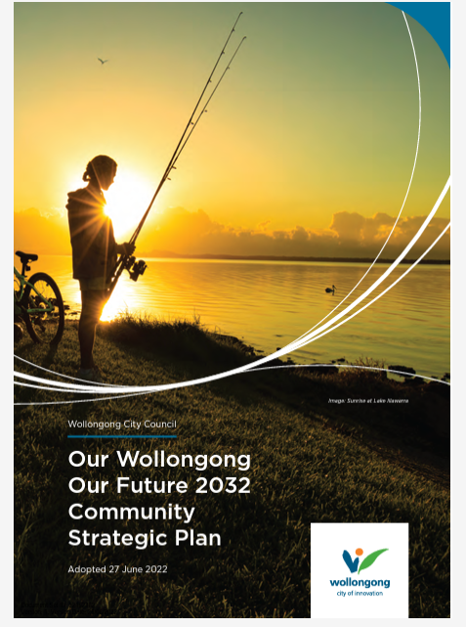
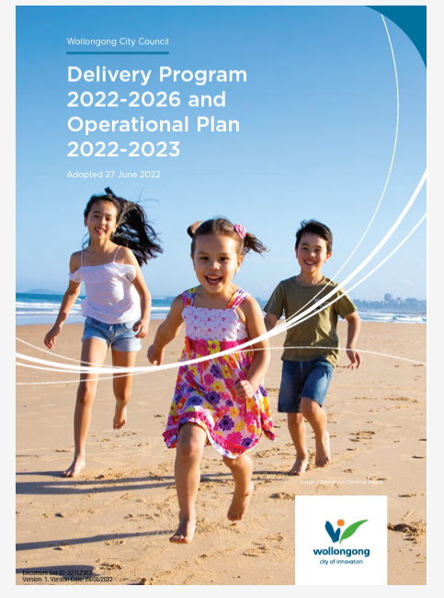
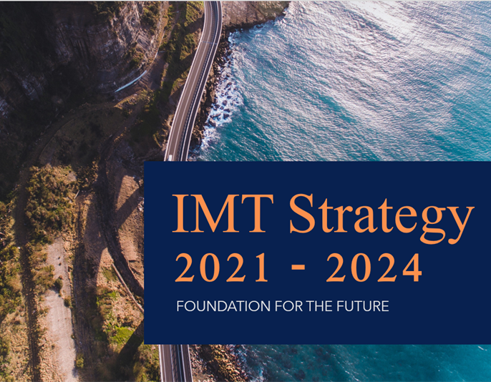
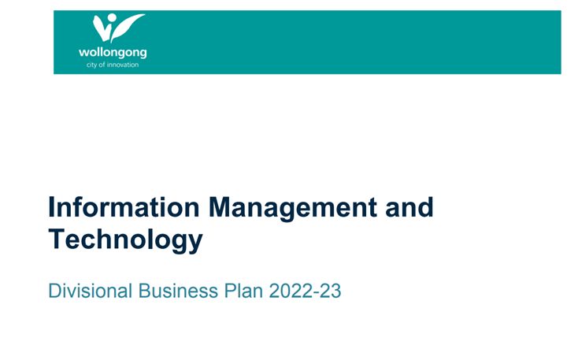
It all started with the Strategy
Notes:
It started with an Information Management and Technology Strategy that aligned with the Organisation’s objectives with business goals and was co-created with the organisation’s executive and middle management.
We redesigned business and products around customer-focussed outcomes, including using cloud services to accelerate change. We embraced mobility, artificial intelligence, and the Internet of Things to boost operational efficiency and respond to evolving community expectations.
The IMT Strategy is part of the Resourcing strategy for Council approved by the Council.
We needed to redesign the provision of information technology services. Being largely technically and on-premise focussed, the functions needed to be refined and revised. The operating model was redesigned so that the new functions could be delivered. The operating model specified all the functions required to deliver the information and technology strategic objectives and the structure, roles and responsibilities designed to deliver these. It was necessary to retrain our employees in cloud, cyber security, data analytics, DevOPs and other modern technologies. In the business, our field staff also needed training in computer literacy, mobile device utilisation, information privacy and cyber security. We also created strategic relationships with a handful of external providers.

Slide 5
A cultural change was required
Sustainable
Use our community’s resources responsibly
Courage
Challenge the norm to be better
Respect
Inclusive and considerate
Integrity
Honest and reliable
One Team
Together we deliver excellent service
Notes:
But, more importantly, a cultural change was required to support this digital transformation.
In 2018 staff also participated in a refresh of our organisational values.
The focus was on creating an enabling space to shape the choices that people make daily. The values encouraged collaboration, innovation, interdependence, belonging, and inclusion.
But most importantly the refreshed values provided the framework and the language to being open to having the courage to challenge the norm, while being respectful and ensuring that sustainability and working across information silos was paramount.
The cultural change was imperative in supporting the digital transformation journey that was about to begin.

Slide 6
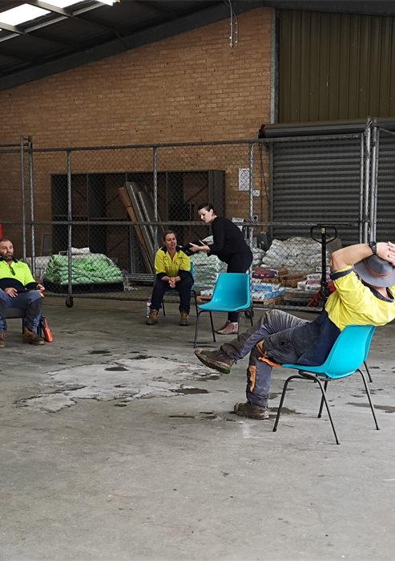
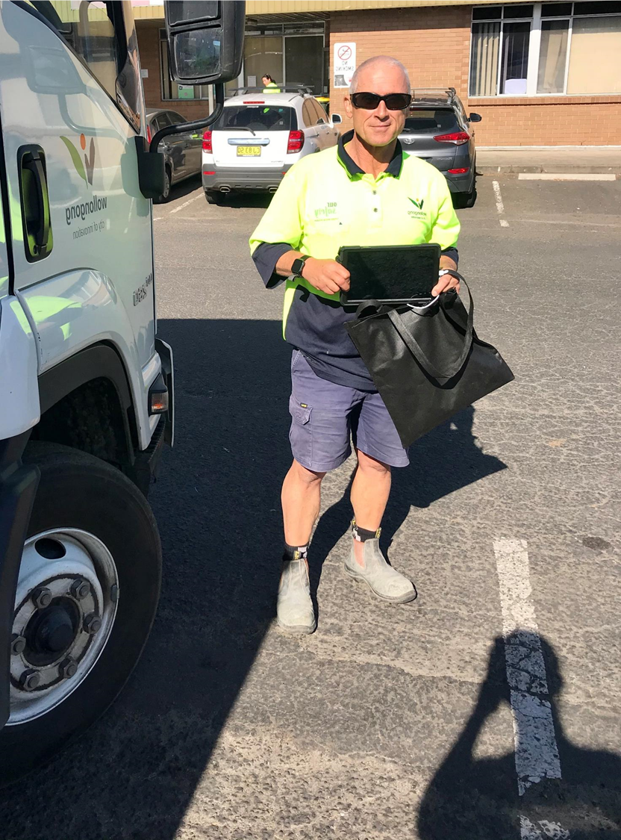
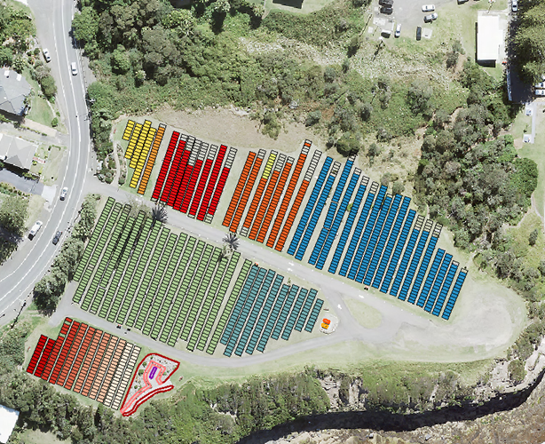
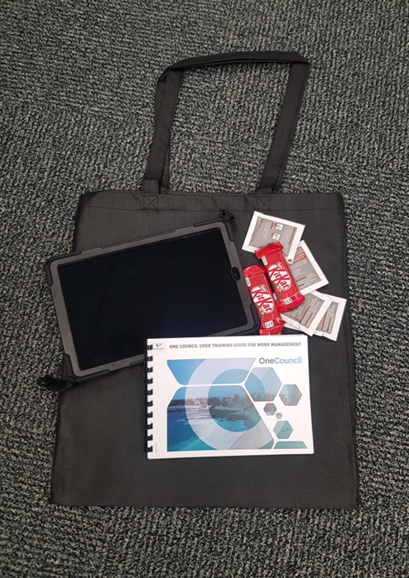
The journey continues…
Notes:
According to Capgemini Digital Transformation Institute and MIT Sloan School of Management many digital transformations are delayed or failing due to poor leadership, disconnects between IT and the business, lagging employee engagement, and substandard operations.
However, key to the demise of many digital transformation projects is the use of cost cutting as a driver, a big-bang approach, and a failure to include the business in planning and implementation.
At Wollongong City Council we have adopted an agile approach, providing the mechanisms to flex and change should this be required. Let’s face it, who could have seen the COVID-19 pandemic coming!
Our drivers are clear, we are here to create an extraordinary Wollongong through a measured implementation of digitalisation. To ensure this is the case, we have set our baseline and are monitoring our progress. To date we have had a fair degree of success, but the journey continues.

